Slide 1
Introduction to Automation Testing

Slide 2
What is Automation Testing
Automation testing is a Software testing technique to test and compare the actual outcome with the expected outcome.
This can be achieved by writing test scripts or using any automation testing tool.
Test automation is used to automate repetitive tasks and other testing tasks which are difficult to perform manually.
Automation costs are really higher initially. It includes the cost of the tool, then the cost of the automation testing resource and his/her training.
But when the scripts are ready, they can be executed hundreds of times repeatedly with the same accuracy and rather quickly. This will save many hours of manual testing. So the cost gradually decreases, and ultimately it becomes a cost-effective method for Regression testing.

Slide 3
When to automate an application
Do the Automation testing in the following scenario of the Software,
Requirements do not change frequently
Access the application for load and performance with many virtual users
Steady Software with respect to manual testing
Obtainability of time
Huge and serious projects
Projects that need to test the same areas often

Slide 4
Different Automation tools
These are some tools which can be helpful in Automation testing,
HP Quick Test Professional
Selenium
Visual Studio Test Professional
WATIR
IBM Rational Functional Tester
TestComplete
Testing Anywhere
WinRunner
SilkTest

Slide 5
Steps to follow in Automation testing
There are lots of helpful tools to write automation scripts, before using those tools it’s better to identify the process which can be used to automate the testing
Identify areas within software to automate
Choose the appropriate tool for test automation
Write test scripts
Develop test suits
Execute test scripts
Build result reports
Find possible bugs or performance issue

Slide 6
Which Test Cases to Automate
There are few Test Cases which should be Automated
Repetitive Test Runs
High-Risk Test Cases
Critical Parts of A Web Application
Evaluate the Pros and Cons
Three Golden Tests- Regression, Sanity and Smoke
If You Can Answer the Magical Question “Why?”
Complex Cases
Long Testing
Extensive Tests

Slide 7
Automation challenges & Mitigations
Deciding what to automate
Picking the right automation tool
Team communication and collaboration
Choosing a testing approach /framework
Initial Investment
Understanding the expectations of stakeholders and end-users
Knowing when to begin and stop testing or How much test coverage is enough ?
Continuous improvement and refactoring

Slide 8
Common Misconceptions About Automated Testing
Automation will provide you with more free time
The Cost of Automated Testing is Too High
Automated Testing is Better Than Manual Testing
Automated Testing Inhibits Human Interaction

Slide 9
Automation Rules
Testing tools are usually very expensive. The Test Manger or the Test leadhas to think twice before going in for automating his test effort. There arealso some widely held false notions or beliefs about automation tools. Ingeneral, the golden rules that should be kept in mind in the regard are:
Product feature understanding, test planning, test casedocumentation, test bed setup, defect tracking, progression tests areall done in manual mode.
Test automation success depends on robustness of the test casesnot on the test tool.
Every manual step has commands in test script.
If it is not worth, DO NOT automate.
Do not build application logic in your test script.
Always have a common known base state for test cases.
One test script must address one test case.

Slide 10
Introduction to Selenium

Slide 11
What is selenium
Selenium is an open source tool which is used for automating the tests carried out on web browsers (Web applications are tested using any web browser).
Since Selenium is open-source, there is no licensing cost involved, which is a major advantage over other testing tools
Reasons behind Selenium’s ever growing popularity are:
Test scripts can be written in any of these programming languages: Java, Python, C#, PHP, Ruby, Perl & .Net
Tests can be carried out in any of these OS: Windows, Mac or Linux
Tests can be carried out using any browser: Mozilla Firefox, Internet Explorer, Google Chrome, Safari or Opera
It can be integrated with tools such as TestNG & JUnit for managing test cases and generating reportsIt can be integrated with Maven, Jenkins & Docker to achieve Continuous Testing

Slide 12
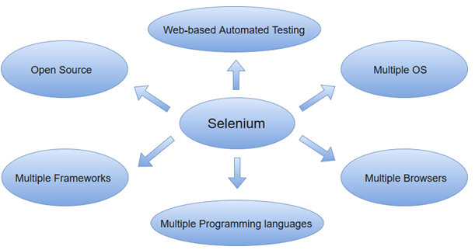
Selenium features

Slide 13
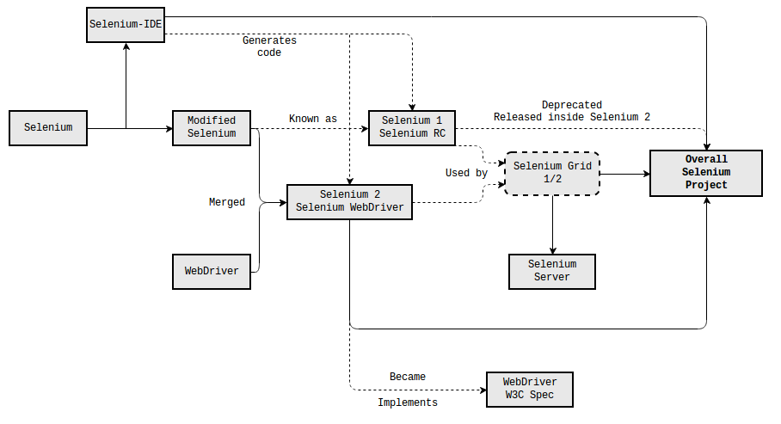
History and various versions of selenium

Slide 14
Comparison of Selenium versions
Version | Version | Comparison
Selenium 1 | Selenium RC | Essentially the same thing. Selenium 1 has never been an official name, but is commonly used in order to distinguish between versions.
Selenium 2,3,4 | Selenium WebDriver | Essentially the same thing. The term "Selenium WebDriver" is now more commonly used.
Selenium RC | Selenium WebDriver | Selenium RC is the predecessor of Selenium WebDriver. It has been deprecated and now released inside Selenium WebDriver for backward compatibility.
Selenium IDE | Selenium RC/WebDriver | Selenium IDE is a recording tool for automating Firefox, with the ability to generate simple RC/WebDriver code. Selenium RC/WebDriver are frameworks to automate browsers programmatically.
Selenium Grid | Selenium WebDriver | Selenium Grid is a tool to execute Selenium tests in parallel on different machines. Selenium WebDriver is the core library to drive web browsers on a single machine.

Slide 15
Selenium Comparison with other automated tool
Features | Selenium | QTP | RFT
Open Source | Yes | No | No
Support | Open Source Community | Dedicated Support | Dedicated Support
Coding Skills Required | Yes | No | No
OS Support | Windows, Linux, Mac | Windows | Windows
Languages Supported | Java, JavaScript, Python, Ruby, Perl, .Net, C sharp | VB Script | Java and C sharp

Slide 16
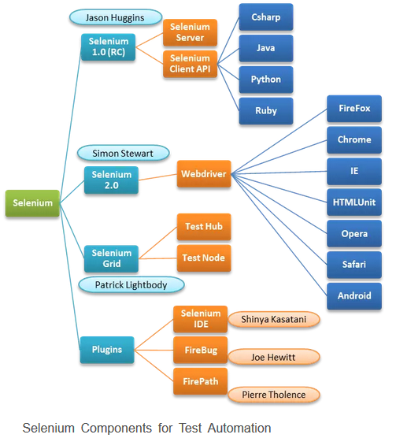
Selenium components

Slide 17
Introduction to Selenium- IDE

Slide 18
Selenium-IDE
This is the simplest suite present in the Selenium suite. Selenium IDE allows to record and playback of the scripts.
It is implemented using the Firefox extension.
By using Selenium, you can record, edit and debug different tests.
The tests created can be easily organized by having different tests in different suites.
The record and playback functionality helps in prototyping the tool and provides the ease of learning.
It acts as an overall solution for developing and maintaining different suites.
Having basic knowledge about HTML, JavaScript and DOM can help the tester in utilizing the best of Selenium IDE.
When the tester creates test cases it provides a feature of auto-completing these.
This helps in entering commands quickly and saves time.
It also reduces the chances of entering invalid commands.

Slide 19
Features of Selenium-IDE
It has an easy record and playback mechanism.
It has the option of automatically asserting the title of every page.
It provides the facility of autocomplete for all frequently used commands.
It provides debugging options with set breakpoints.
Selenium supports user extensions like .js file.
It makes use of intelligent field selection which will make use of IDs, names or XPath as required.

Slide 20
Selenium IDE - Demo

